Slide 1
Tourism Exploration of Nepal
Group Member
Bajgain Binod
Adhikari Bikram
Bogati Surendra

Slide 2
Introduction
Project Name: Tourism In Nepal
Our website is dedicated to showcasing the diversity and beauty of our country Nepal, offering a unique blend of tourism exploration where we have shown the different beautiful destinations of Nepal along with different packages for tourist.

Slide 3
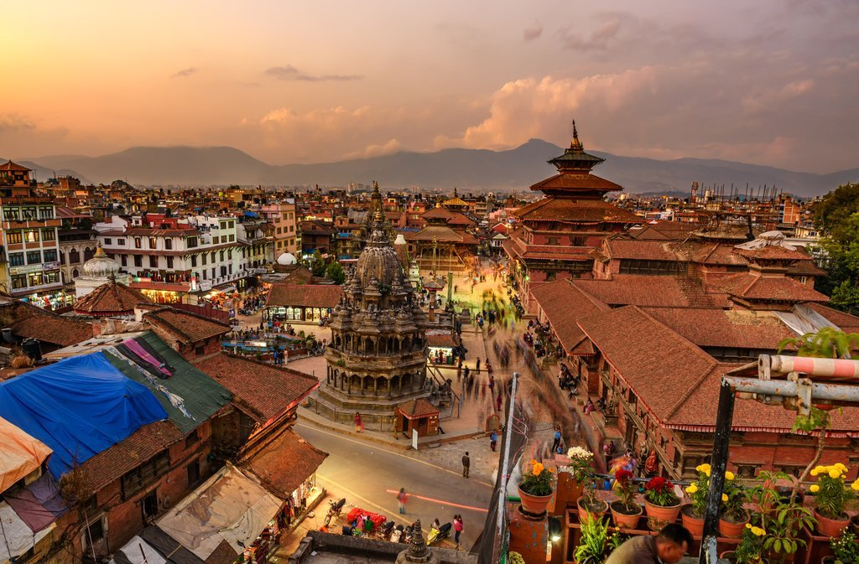
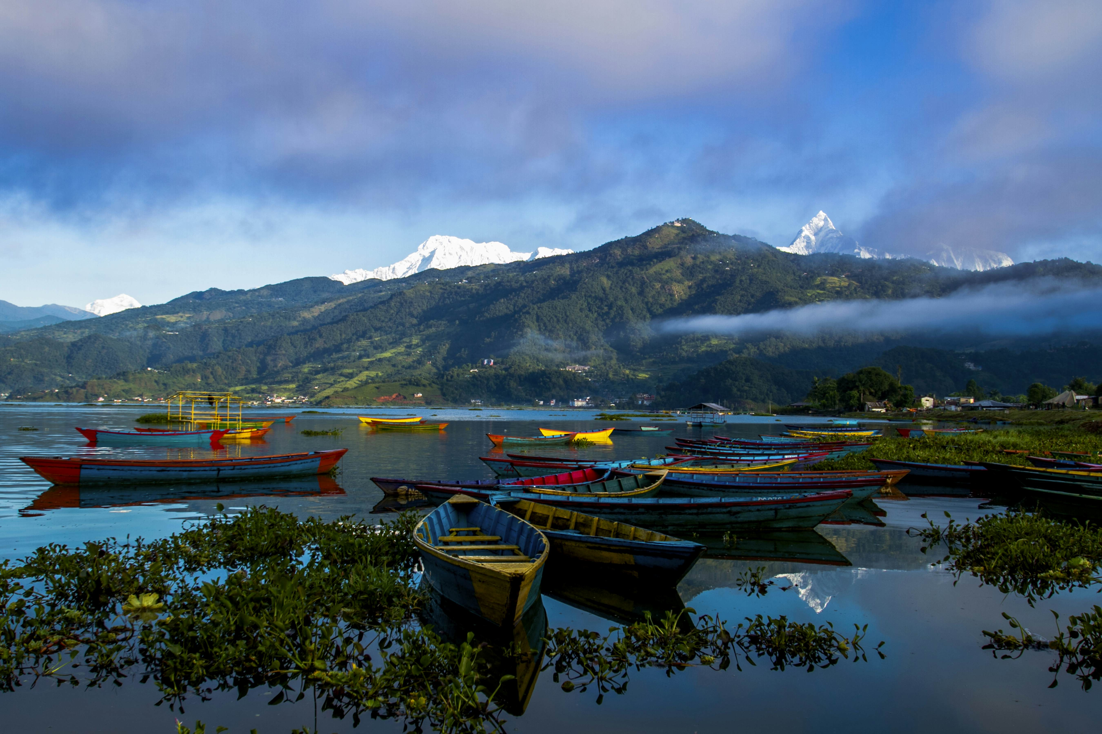
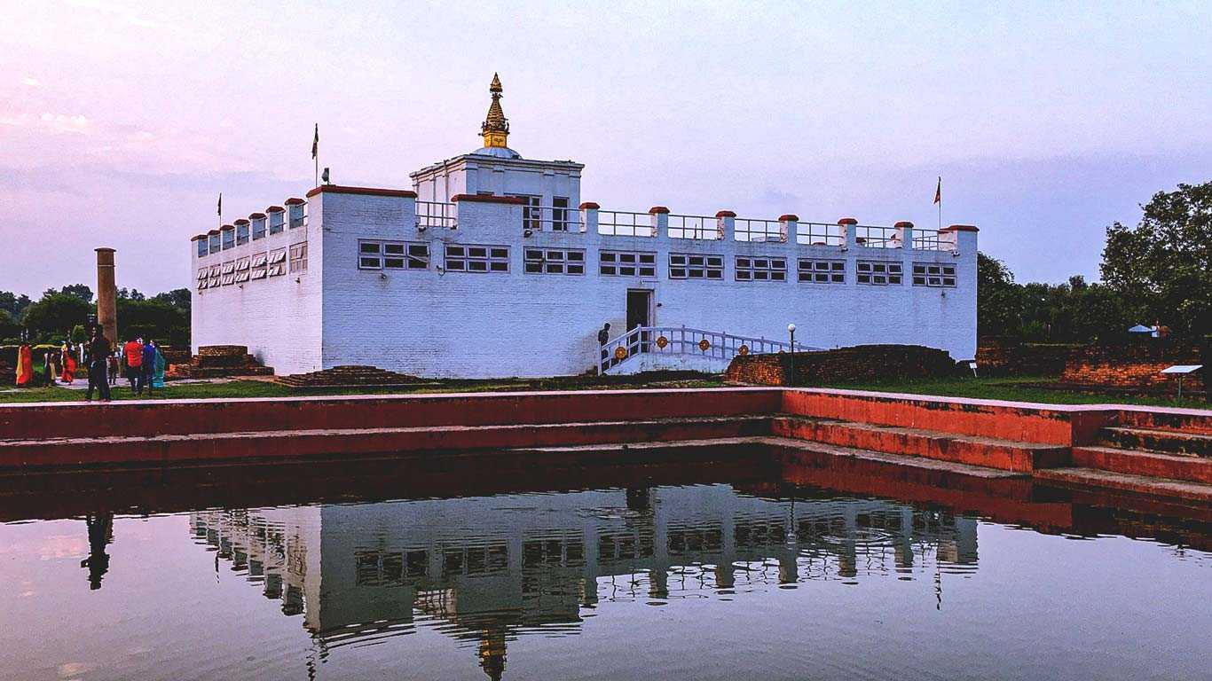
Popular Destination of Nepal
Kathmandu
Pokhara
Lumbini

Slide 4
Website Features
Homepage:
Welcome message introducing Nepal
Overview of the rich cultural, Diversity and natural heritage of Nepal
About:
Highlighting about background of Nepal
Packages
Highlights of different Packages
  Wildlife tour package
  Buddhism tour package
  Adventure package
Destinations
  Popular destinations in Nepal
    Kathmandu
    Pokhara
    Lumbini

Slide 5
Blogs
Highlights of exploring Kathmandu Valley
Highlights of Trekking in the Annapurna Region
Contact Us
Website visitor can message their queries via mail

Slide 6
Technologies Used
HTML (Hypertext Markup Language):
Foundation of our website’s structure and content presentation.
Utilized to create semantic markup for various sections: homepage, destinations, about, blogs.
CSS (Cascading Style Sheets):
Used for styling and layout design to enhance visual appeal and user experience.
Custom styles applied to ensure consistency in typography, colors, and responsive design across different devices..
JavaScript:
Enhances interactivity and functionality of website
Implemented for dynamic elements such as navigation though webpage
Used for form validation, contact us form

Slide 7
Thank you

